Slide 1
APA引用格式
第二次公外助教教学

Slide 2
1.In-Text citation
2.The reference list
Contents
3.Exercise

Slide 3
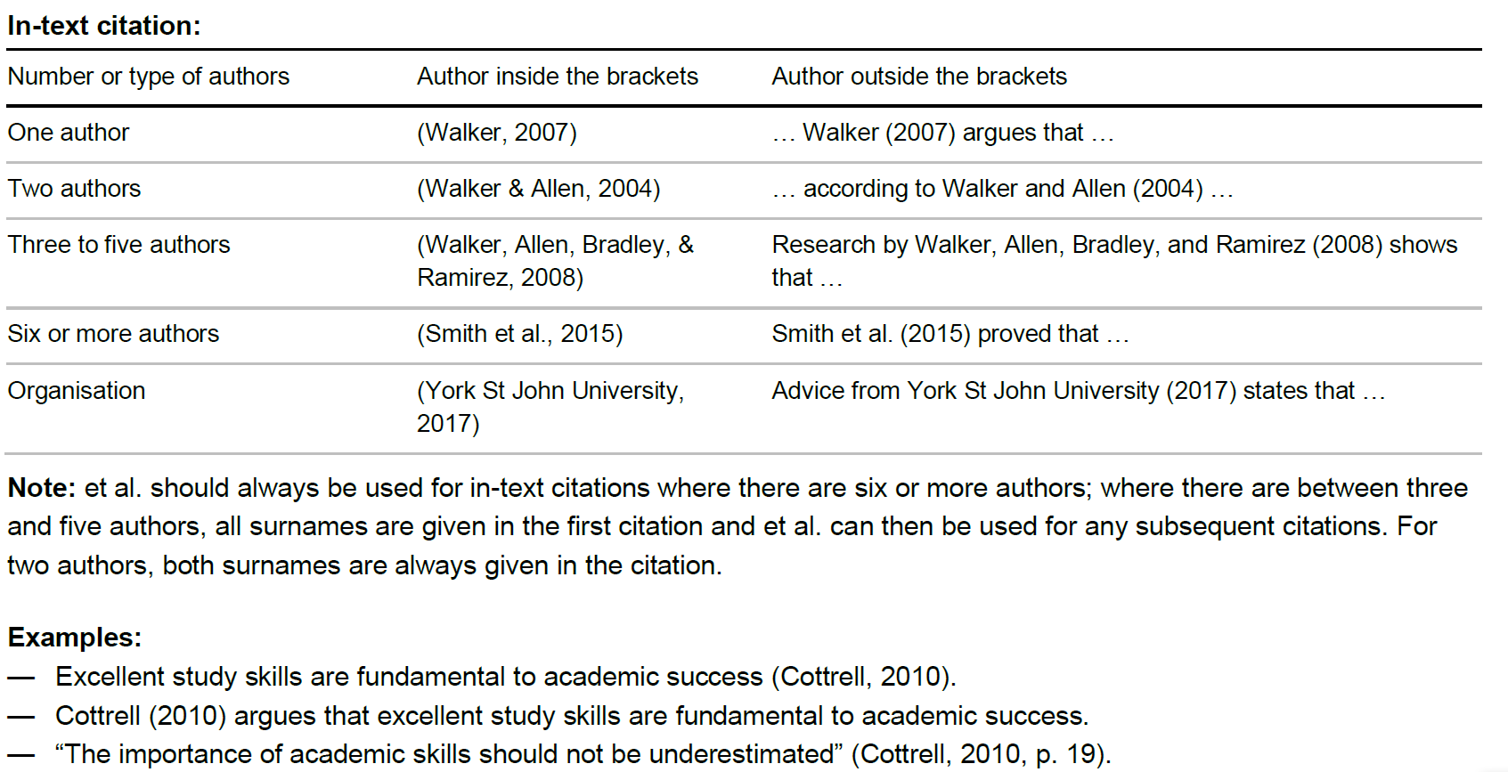

Slide 4
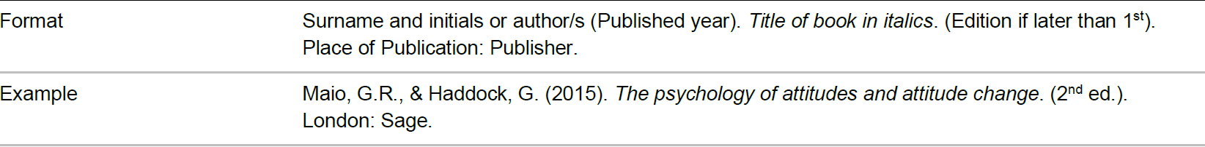
Your reference list should be completed in alphabetical order by author’s surname, regardless of the type of source. Only sources that you have directly cited in your work should be included; a separate bibliography is not required.
Books
二季度
请在这里输入文字请在这里输入
Chapters

Slide 5
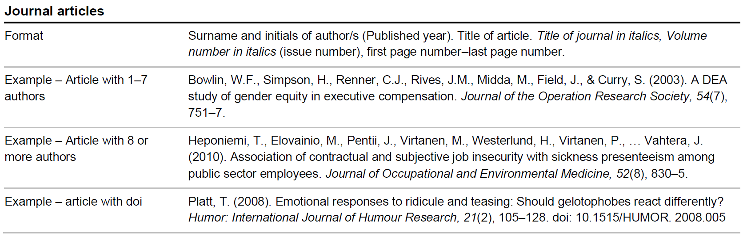
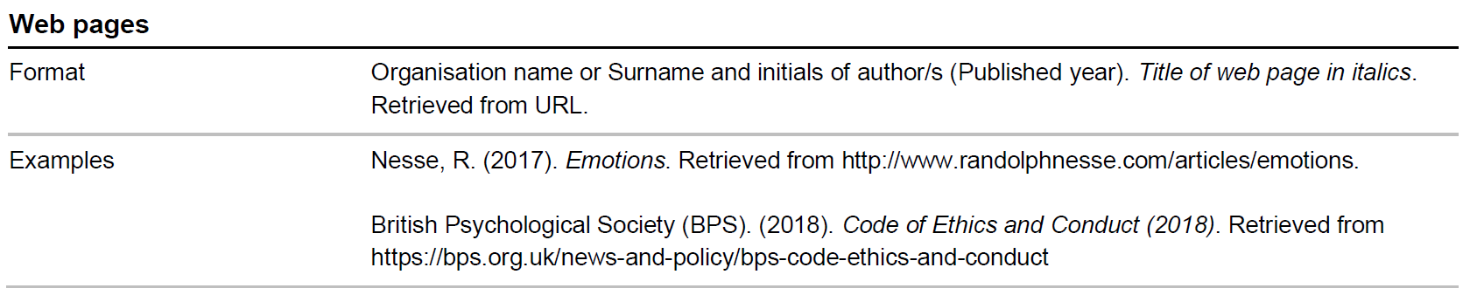
请在这里输入文字请在这里输入文字请在这里输入文字请在这里输入文字

Slide 7
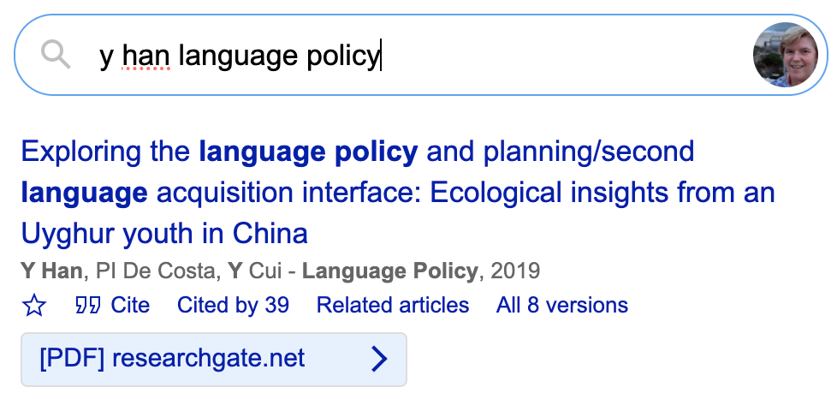
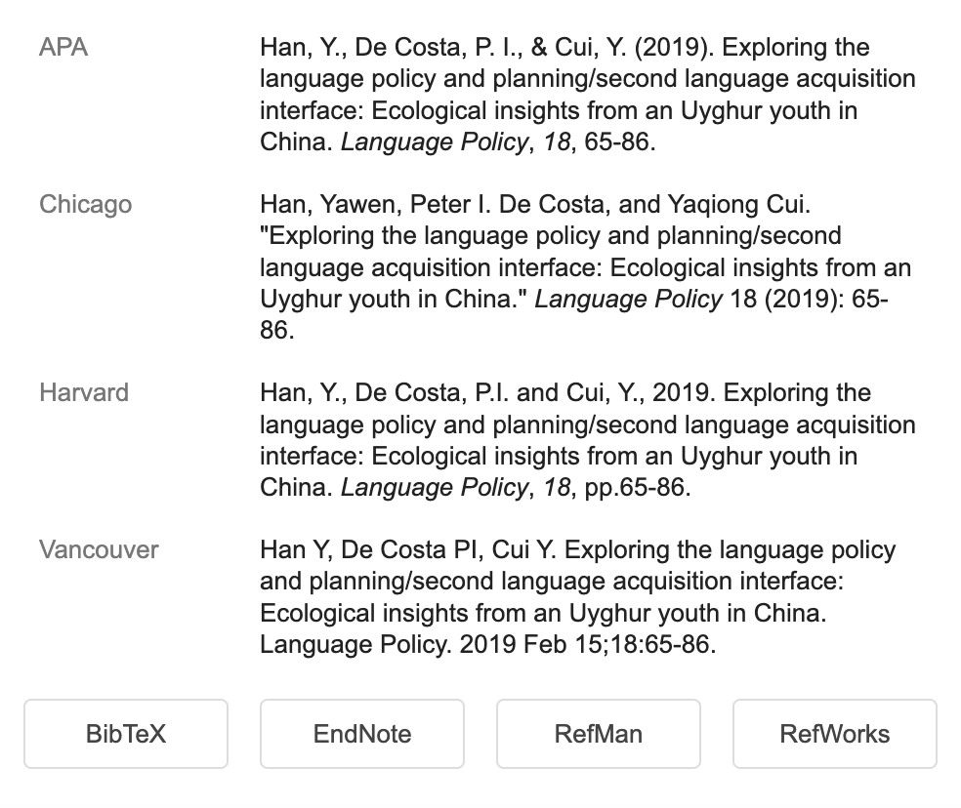
These days, there is little need to create your own bibliography by typing in everything yourself. You could:
1) Use Google scholar to get the citation, and choose from a variety of citation styles (see Figures 1 & 2). Just be careful because Google scholar works well for articles but not very well for books, especially edited books.
If you use a reference manager, such as EndNote or RefWorks, you can also use Google Scholar to give you a pre-made template for those applications as well.

Slide 8
Exercise
A multitude of studies have shown that learners who begin acquisition of a second language after the age of 12 can rarely produce a sentence or even a word in a second language (L2) without a noticeable accent (Asher & Garcia, 1969; Bongaerts, 1999; Flege & Fletcher, 1992; Major, 2001; Moyer, 1999; Pisoni, Aslin, et al., 1982) . Likewise, many studies have found that L2 learners have trouble perceiving certain contrasts in the L2 that are simply not difficult for native speakers (NS) of the language to perceive (for example, Best (2001) for Zulu plosive versus implosive bilabial stops perceived by native English speakers; Brown (2001) for American English /r/ and /l/ perceived by native Japanese speakers). Hao & Yang (2021) also found problems with tonal acquisition. Asher and Garcia (1969, p. xxx) state that “nonnative speaker phonologies range from nativelike to barely understandable”. These facts are clear, but researchers investigating the L2 acquisition of phonology have still not identified to the satisfaction of all the factors that can lead to success (or hinder the learners) in the production and perception of L2 phonology.
In APA 7th, for in-text citations, 3 or more authors should be referred to only by the first author’s name: Pisoni, 1982; In addition, et al. stands for ‘et alia’ so there needs to be a period after ‘al’.
Multiple authors should be listed in alphabetical order separated by semicolons.
Outside of the parentheses, the word ‘and’ should be spelled out between authors’ names.
A direct quotation requires page numbers if it comes from a printed source (no page numbers needed if using only electronic source)

Slide 9
Asher, J. J., & Garcia, R. (1969). The optimal age to learn a foreign language . The Modern Language Journal, 53, 334-341.
Best, C., McRoberts, G. W., & Goodell, E. (2001). Discrimination of non-native consonant contrasts varying in perceptual assimilation to the listener's native phonological system. Journal of the Acoustical Society of America , 209(2), 775-794.
Brown, C. (2000). The interrelation between speech perception and phonological acquisition from infant to adult. In Archibald, J., (Editor), Second language acquisition and linguistic theory, (pp. 4-63). Malden, MA: Blackwell.
Hao, Y. - C., & Yang, C. - L. M. (2021). The effect of second-language orthographic input on the phonological encoding of Mandarin words. Applied Psycholinguistics, 42(4), 887-906.
Major, R. C. (2001). Foreign Accent: The Ontogeny and Phylogeny of Second Language Phonology. Taylor & Francis .
Moyer, Alene. (1999). Ultimate attainment in L2 phonology: the critical factors of age, motivation and instruction. Studies in second language acquisition , 21, 81-108
Pisoni, D. B., Aslin, R. N., et al. (1982). Some effects of laboratory training on identification and discrimination of voicing contrasts in stop consonants. Journal of Experimental Psychology: Human Perception and Performance, 8(2), 297-314.
This should not be underlined. The journal name is italicized.
The Journal title is only italicized, not italicized and underlined.
The editor’s name should be first initial(s) then last name (the opposite of the author’s name). Also, the word “Editor” should be shortened to “Ed.” or “Eds.” for more than one editor.
In the references list, the last author should have “&” before their name, not the word ‘and’ spelled out.
The year should be entered after the author names, not at the end of the reference.
Names with hyphens should be spelled with no space between the initials and the hyphen, like this: Y.-C. and also C.-L. M.
This book needs a publisher listed.
In APA only the first letter of the article or book name is capitalized, and also the first word after a colon that indicates a subtitle. So in this title, only Ultimate and The should be capitalized. This is also true for the name of the
In The order of the name of the article and the journal name were incorrect. They have been fixed here.

Slide 10
Thank you very much~

